Slide 1
Naïve Bayes Classification
10-701 Recitation, 1/25/07
Jonathan Huang

Slide 2
Things We’d Like to Do
Spam Classification
  Given an email, predict whether it is spam or not
Medical Diagnosis
  Given a list of symptoms, predict whether a patient has cancer or not
Weather
  Based on temperature, humidity, etc… predict if it will rain tomorrow

Slide 3
Bayesian Classification
Problem statement:
  Given features X₁,X₂,…,X_{n}
  Predict a label Y

Slide 4

Another Application
Digit Recognition
X₁,…,X_{n} ∈ {0,1} (Black vs. White pixels)
Y ∈ {5,6} (predict whether a digit is a 5 or a 6)
Classifier
5

Slide 5

The Bayes Classifier
In class, we saw that a good strategy is to predict:
  (for example: what is the probability that the image represents a 5 given its pixels?)
So … how do we compute that?

Slide 6
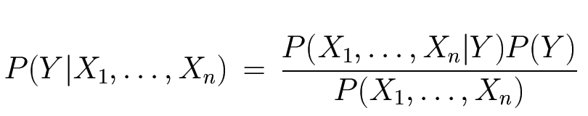
The Bayes Classifier
Use Bayes Rule!
Why did this help? Well, we think that we might be able to specify how features are “generated” by the class label
Likelihood
Prior
Normalization Constant

Slide 7
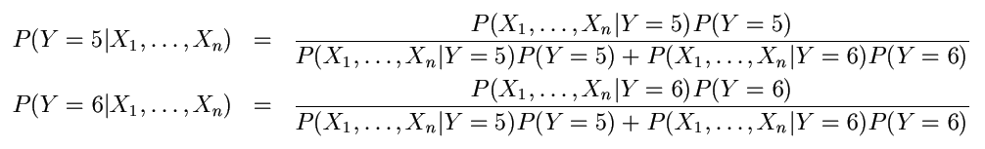
The Bayes Classifier
Let’s expand this for our digit recognition task:
To classify, we’ll simply compute these two probabilities and predict based on which one is greater

Slide 8
Model Parameters
For the Bayes classifier, we need to “learn” two functions, the likelihood and the prior
How many parameters are required to specify the prior for our digit recognition example?
Just 1

Slide 9
Model Parameters
How many parameters are required to specify the likelihood?
  (Supposing that each image is 30x30 pixels)
2(2⁹⁰⁰-1)

Slide 10
Model Parameters
The problem with explicitly modeling P(X₁,…,X_{n}|Y) is that there are usually way too many parameters:
  We’ll run out of space
  We’ll run out of time
  And we’ll need tons of training data (which is usually not available)

Slide 11
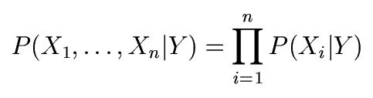
The Naïve Bayes Model
The Naïve Bayes Assumption: Assume that all features are independent given the class label Y
Equationally speaking:
(We will discuss the validity of this assumption later)

Slide 12
Why is this useful?
# of parameters for modeling P(X₁,…,X_{n}|Y):
  2(2^{n}-1)
# of parameters for modeling P(X₁|Y),…,P(X_{n}|Y)
  2n

Slide 13
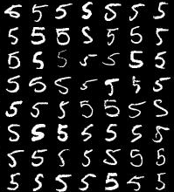
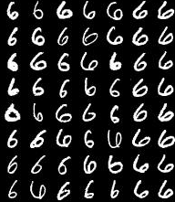
Naïve Bayes Training
Now that we’ve decided to use a Naïve Bayes classifier, we need to train it with some data:
MNIST Training Data

Slide 14
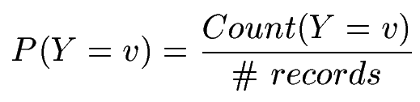

Naïve Bayes Training
Training in Naïve Bayes is easy:
  Estimate P(Y=v) as the fraction of records with Y=v
  Estimate P(X_{i}=u|Y=v) as the fraction of records with Y=v for which X_{i}=u
(This corresponds to Maximum Likelihood estimation of model parameters)

Slide 15
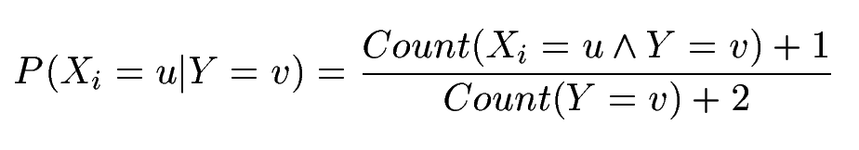
Naïve Bayes Training
In practice, some of these counts can be zero
Fix this by adding “virtual” counts:
  (This is like putting a prior on parameters and doing MAP estimation instead of MLE)
  This is called Smoothing

Slide 16
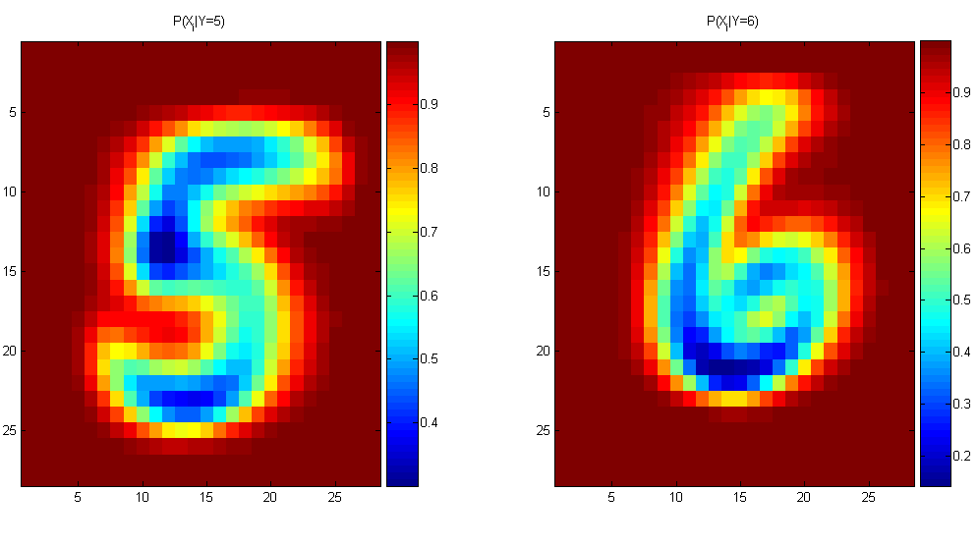
Naïve Bayes Training
For binary digits, training amounts to averaging all of the training fives together and all of the training sixes together.

Slide 17
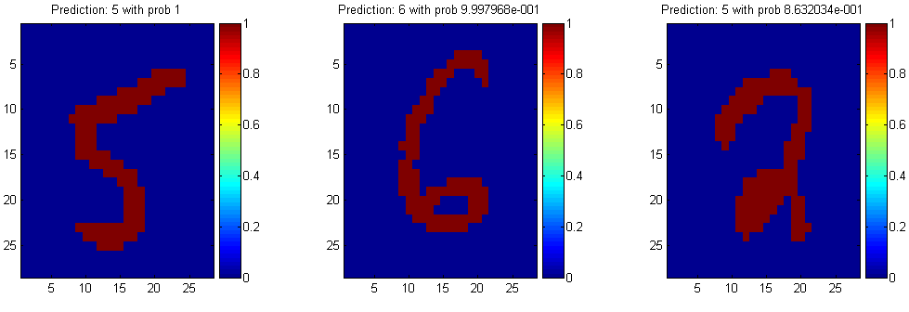
Naïve Bayes Classification

Slide 18
Outputting Probabilities
What’s nice about Naïve Bayes (and generative models in general) is that it returns probabilities
  These probabilities can tell us how confident the algorithm is
  So… don’t throw away those probabilities!

Slide 19
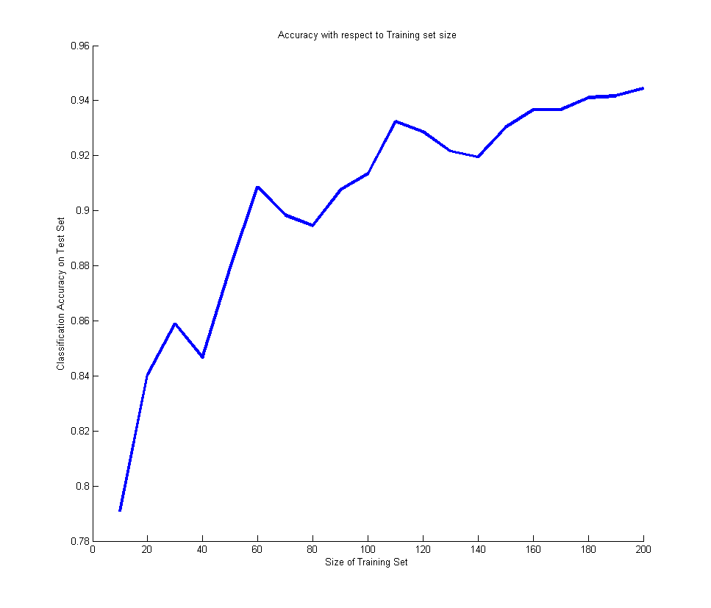
Performance on a Test Set
Naïve Bayes is often a good choice if you don’t have much training data!

Slide 20
Naïve Bayes Assumption
Recall the Naïve Bayes assumption:
  that all features are independent given the class label Y
Does this hold for the digit recognition problem?

Slide 21
Exclusive-OR Example
For an example where conditional independence fails:
  Y=XOR(X₁,X₂)
X₁ | X₂ | P(Y=0|X₁,X₂) | P(Y=1|X₁,X₂)
0 | 0 | 1 | 0
0 | 1 | 0 | 1
1 | 0 | 0 | 1
1 | 1 | 1 | 0

Slide 22
Actually, the Naïve Bayes assumption is almost never true
Still… Naïve Bayes often performs surprisingly well even when its assumptions do not hold

Slide 23
Numerical Stability
It is often the case that machine learning algorithms need to work with very small numbers
  Imagine computing the probability of 2000 independent coin flips
  MATLAB thinks that (.5)²⁰⁰⁰=0

Slide 24
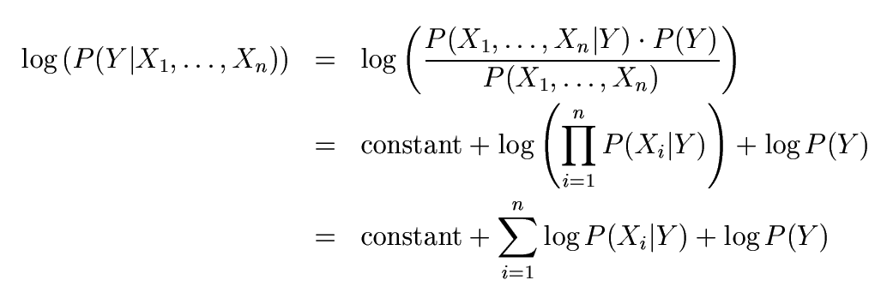
Numerical Stability
Instead of comparing P(Y=5|X₁,…,X_{n}) with P(Y=6|X₁,…,X_{n}),
  Compare their logarithms

Slide 25


Recovering the Probabilities
Suppose that for some constant K, we have:
  And
How would we recover the original probabilities?

Slide 26

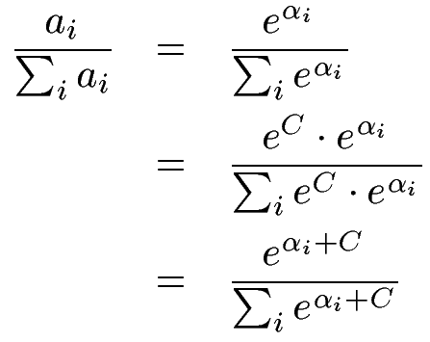

Recovering the Probabilities
Given:
Then for any constant C:
One suggestion: set C such that the greatest α_{i} is shifted to zero:

Slide 27
Recap
We defined a Bayes classifier but saw that it’s intractable to compute P(X₁,…,X_{n}|Y)
We then used the Naïve Bayes assumption – that everything is independent given the class label Y
A natural question: is there some happy compromise where we only assume that some features are conditionally independent?
  Stay Tuned…

Slide 28
Conclusions
Naïve Bayes is:
  Really easy to implement and often works well
  Often a good first thing to try
  Commonly used as a “punching bag” for smarter algorithms

Slide 29
Questions?

